Slide 1
Smart Green Mind
Demo demonstration

Slide 2
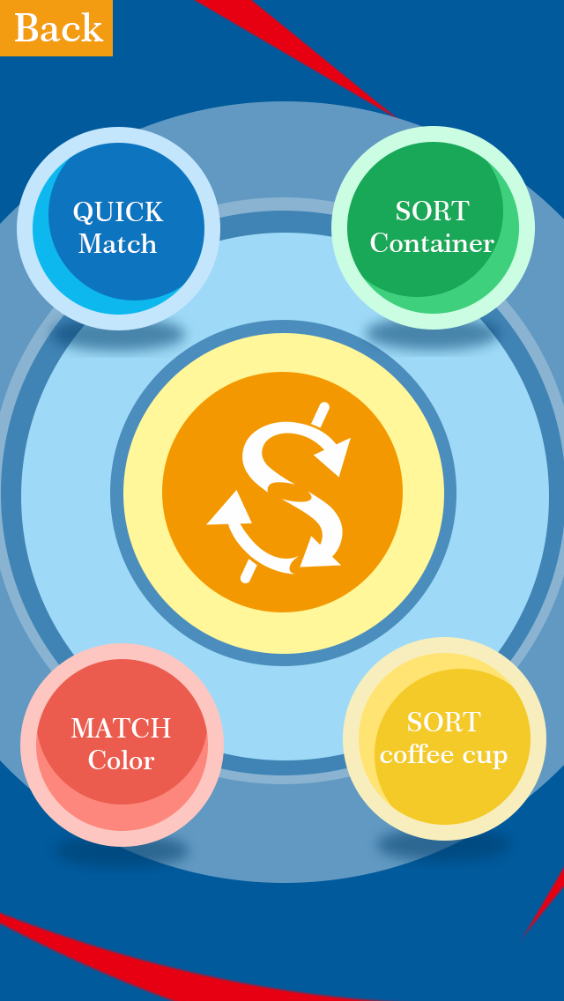
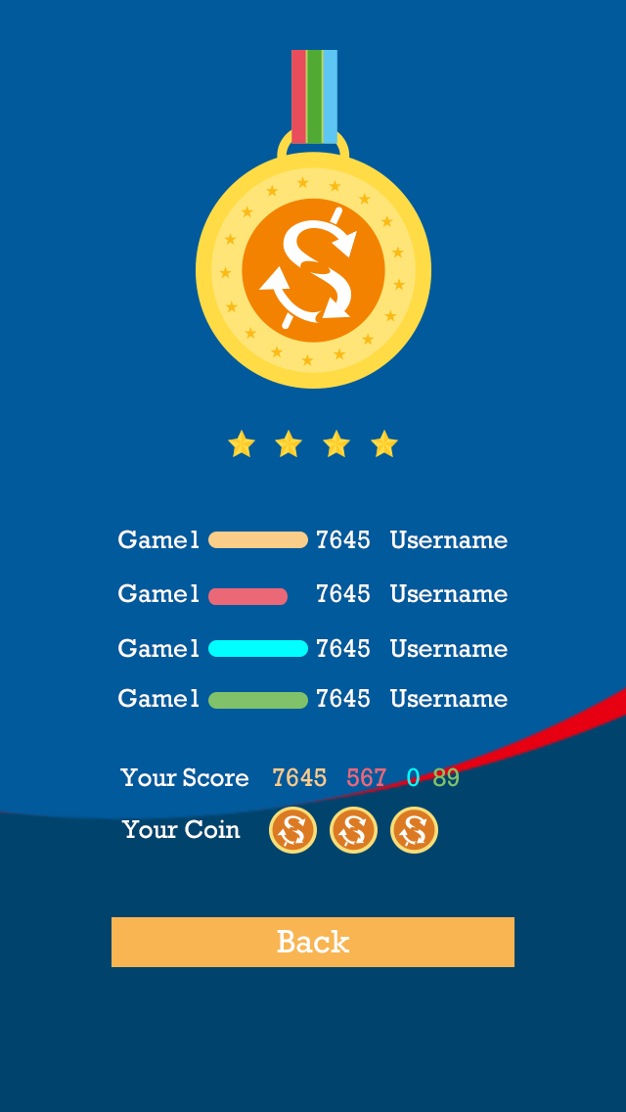
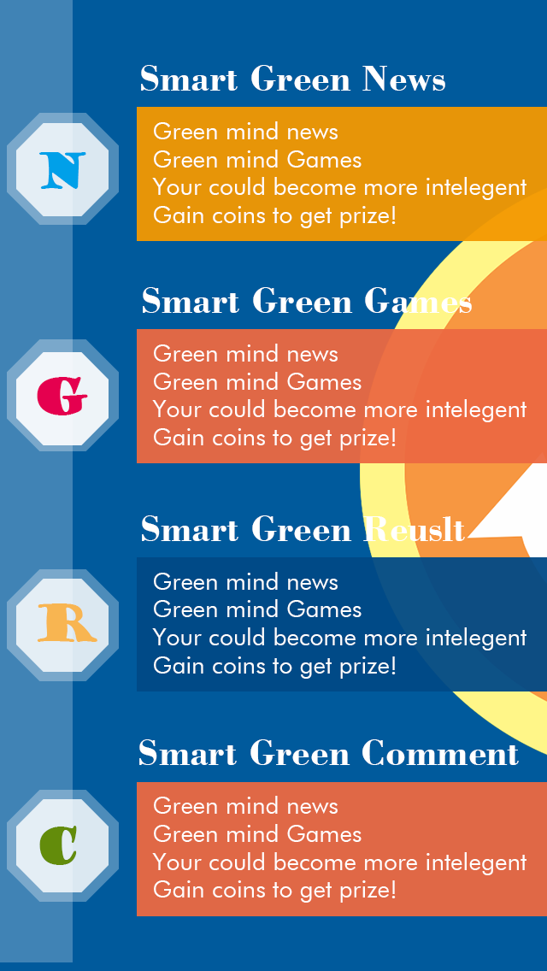
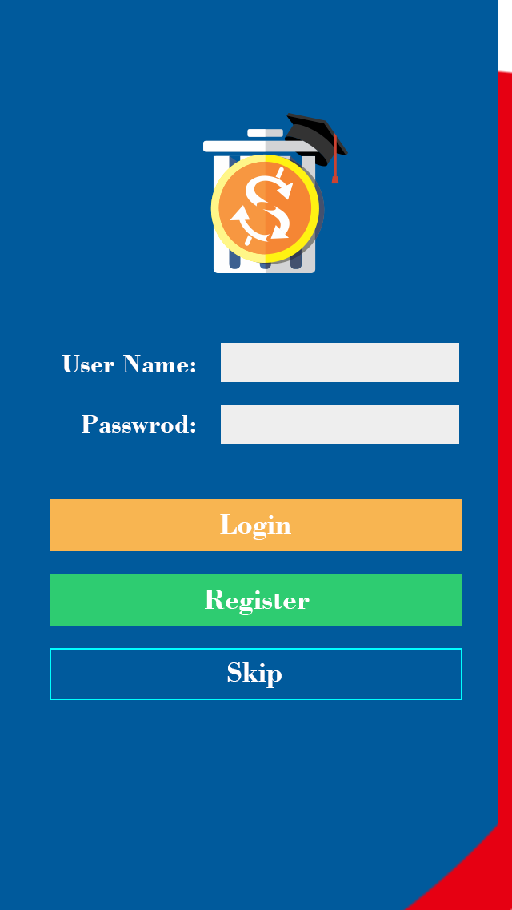

Game Menu Page
Result Page
Main Page
Login Page
Loading Page

Slide 3
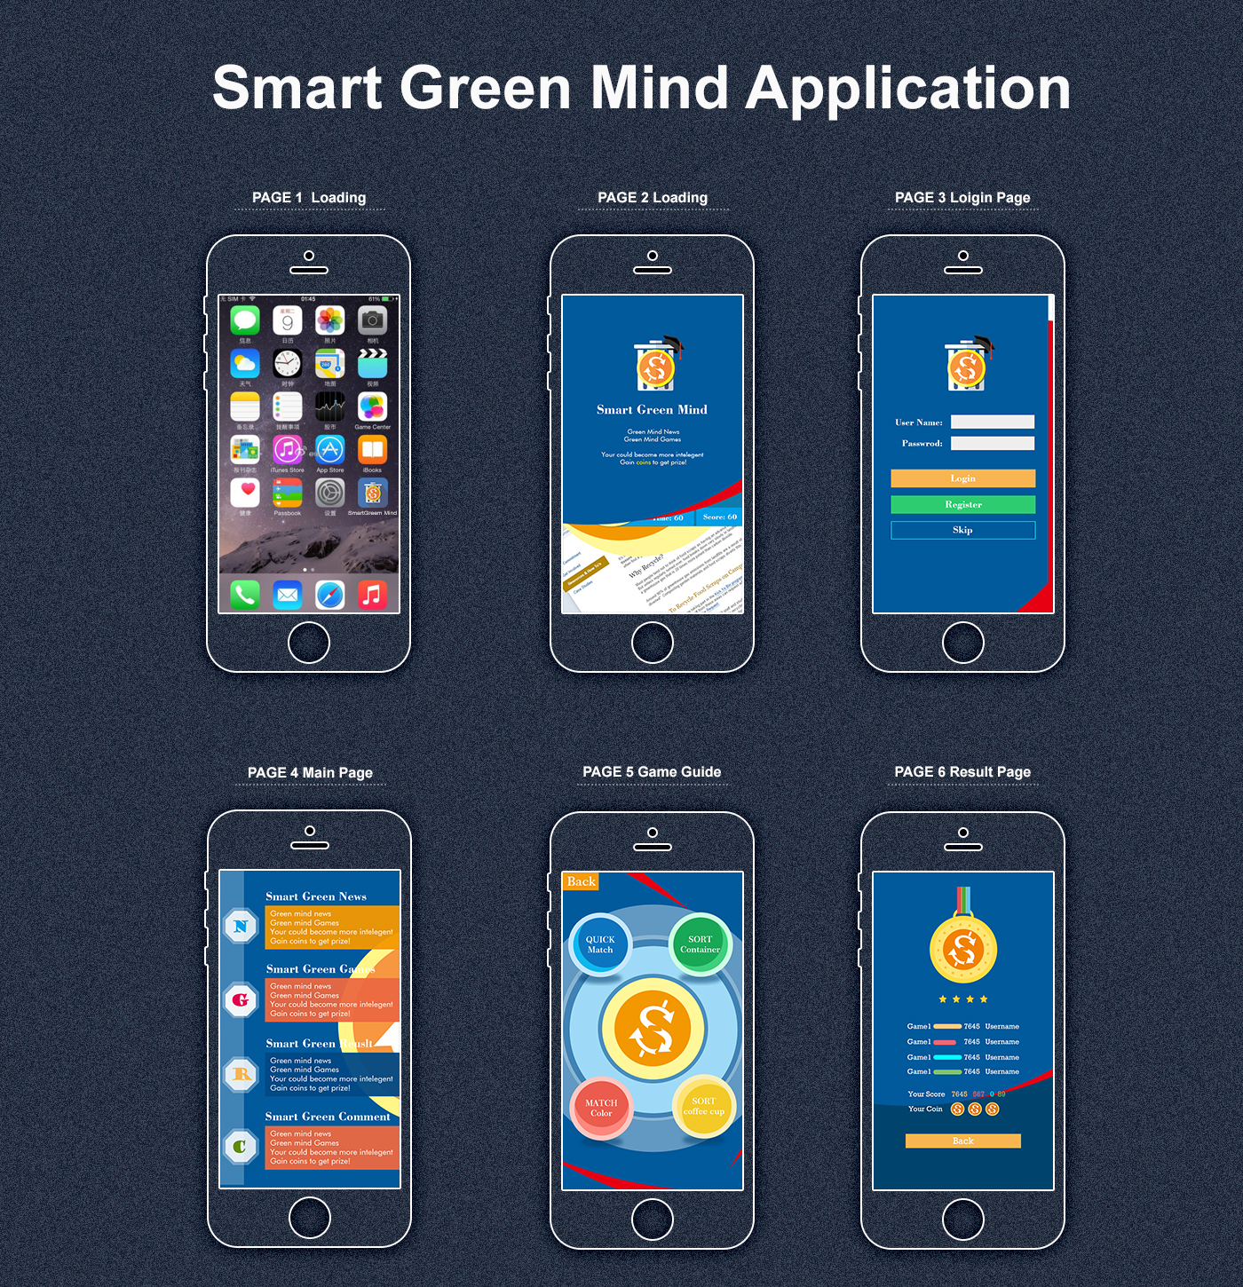
Visual Screen

Slide 4
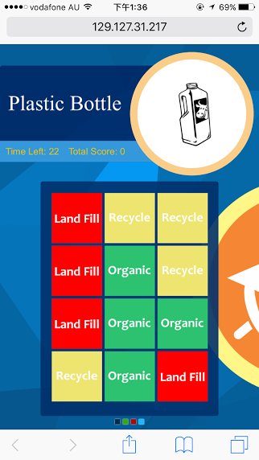
Game1 Match colour(general game) Game2 Quick Sort (general game) Game3 Sort coffee cup(specific game) Game4 container sort(specific game)
Notes:
1.The waste will be displayed randomly.
2. User need to click all right colour blocks according to waste type.

Slide 5

Game1 Match colour(general game) Game2 Quick Sort (general game) Game3 Sort coffee cup(specific game) Game4 container sort(specific game)
Notes:
1.There will be a sequence of waste in the bottom.
2.The player need to drag each waste into correct waste bin.

Slide 6
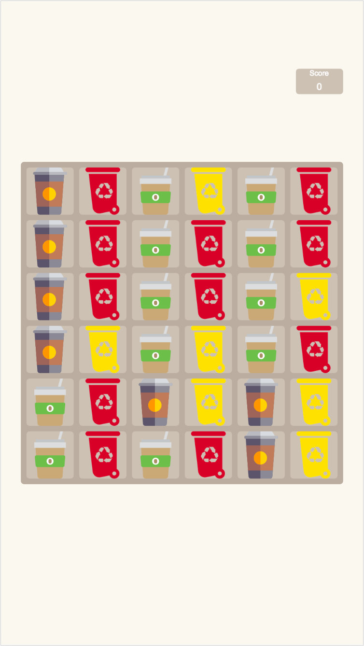
Game1 Match colour(general game) Game2 Quick Sort (general game) Game3 Sort coffee cup(specific game) Game4 container sort(specific game)
Notes:
The waste icons and waste bins wile be displayed randomly.
The user click a waste icon(or bin) first.
Then user need to click a bin(or waste).
The bin(waste) must match the type of waste.

Slide 7
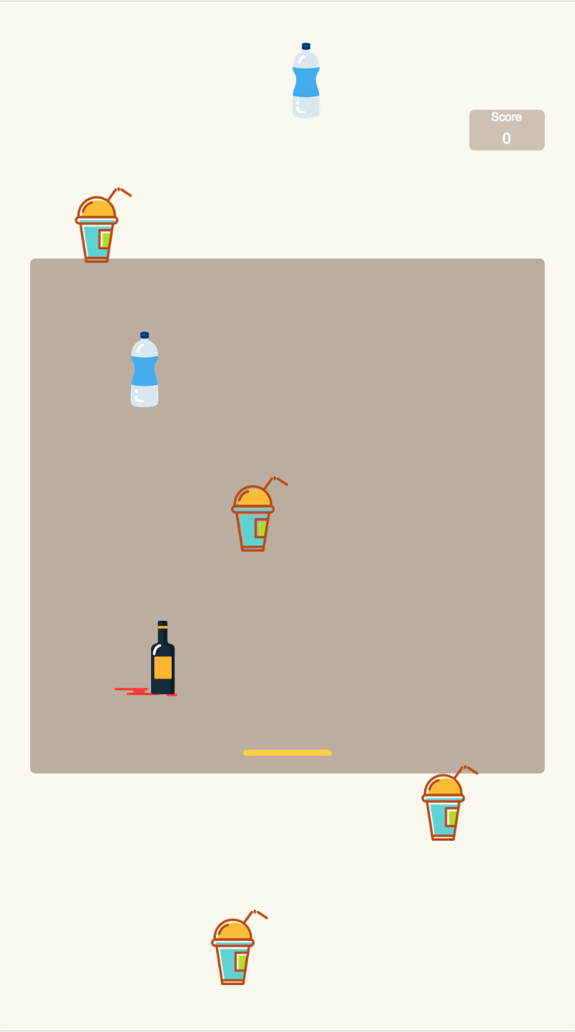
Game1 Match colour(general game) Game2 Quick Sort (general game) Game3 Sort coffee cup(specific game) Game4 container sort(specific game)
Notes:
There will be a “rain” of waste falling down from the top.
User needs to move a bar to catch the waste.
The colour of the bar will change randomly .
When a waste is caught, the colour of the bar must be right according to the waste’s type.

